Slide 1

Searches
Mr. Berry
ICS4U

Slide 2
Introduction
What is “searching” in programming?
Can you name some types of searches?
Why would you need to do a search?

Slide 3
Types of Searching in Programming
Sequential (Linear)
Binary

Slide 4
Sequential Search
Also called a “linear search”
How does it work?
Starts at the beginning of an array or table & checks each element
Search is over when element is found OR it cannot be found
Data does not have to be sorted

Slide 5
Binary Search
A faster way to search a sorted array is to use a “binary search”
The idea is to look at the element in the middle:
  If the key is equal to that, the search is finished
  If the key is less than the middle element, do a binary search on the first half
  If it's greater, do a binary search on the second half
Data must be sorted

Slide 6
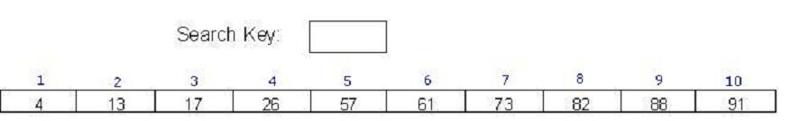
An Example…

Slide 7
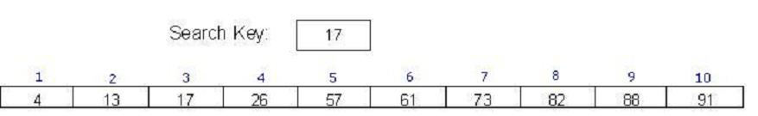
An Example (Cont’d)…

Slide 8
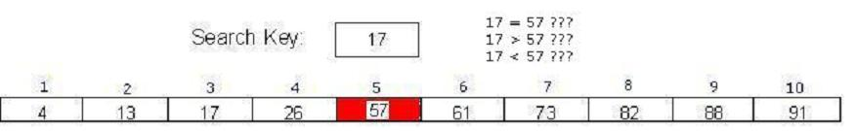
An Example (Cont’d)…

Slide 9
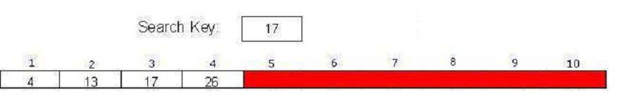
An Example (Cont’d)…

Slide 10
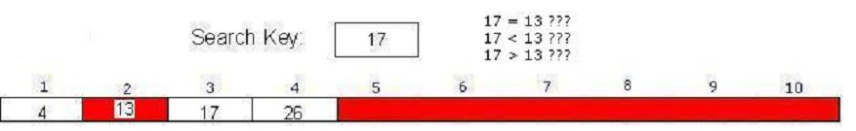
An Example (Cont’d)…

Slide 11
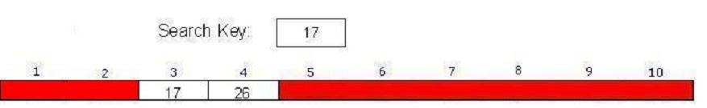
An Example (Cont’d)…

Slide 12
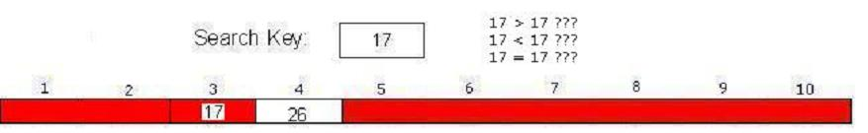
An Example (Cont’d)…

Slide 13
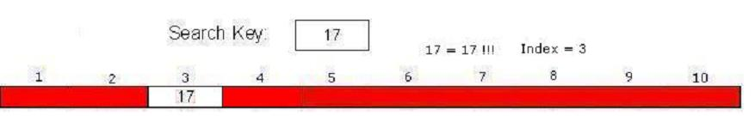
An Example (Cont’d)…

Slide 14
Another Example…

Slide 15
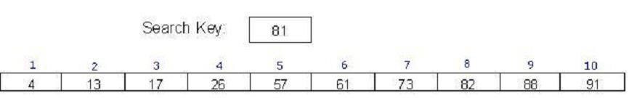
Another Example (Cont’d)…

Slide 16
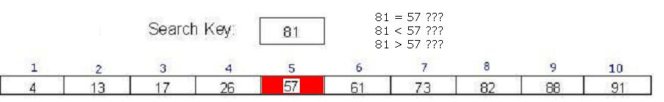
Another Example (Cont’d)…

Slide 17
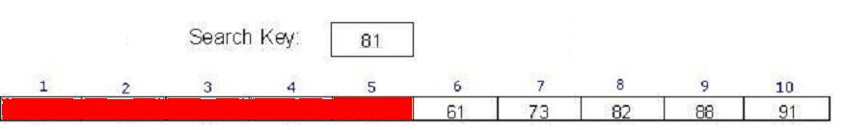
Another Example (Cont’d)…

Slide 18
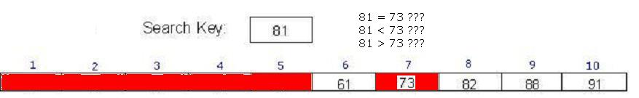
Another Example (Cont’d)…

Slide 19
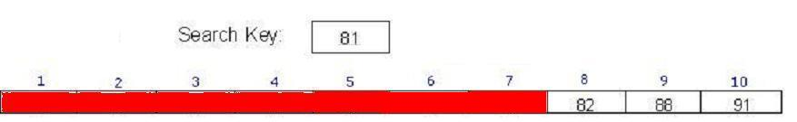
Another Example (Cont’d)…

Slide 20
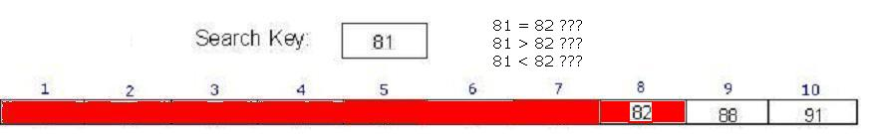
Another Example (Cont’d)…

Slide 21
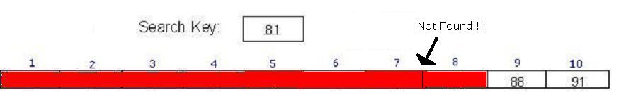

Another Example (Cont’d)…

Slide 22
Recursion Considerations
Base Case:
If the key is equal to the middle element, the search is finished
General Case:
If the key is less than the middle element, do a binary search on first half
If it's greater, do a binary search of the second half
What if the key is not found?

